Slide 1





Network Automation Integration
Discover & Design
Build
Testing
Deploy
Training
Activities & Work Products
Project kickoff
Requirements via In-Person Workshop
Implementation Strategy
Detailed Design Flow Diagrams
Ansible Server Deployment
Playbooks
Build Test Environment
Super-User Test Cases
Shore up Gold Standard Config
Begin Production Building
Update Monitoring and CMDB
Train Network Engineering Staff
Provide Manuals and Runbooks

Slide 2




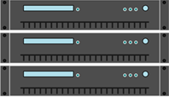
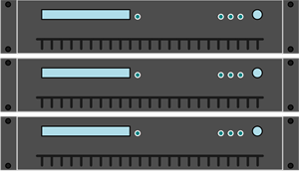
Network Automation Projects
Project Identification
Versioning Control
Ansible Server
Approved script
Playbooks
Create
Network Administrator
Templates
Provision
Modules
Testing Team
Push
Deploy
Network Engineering
Network Equipment

Slide 3
Ansible Life Cycle

Slide 4
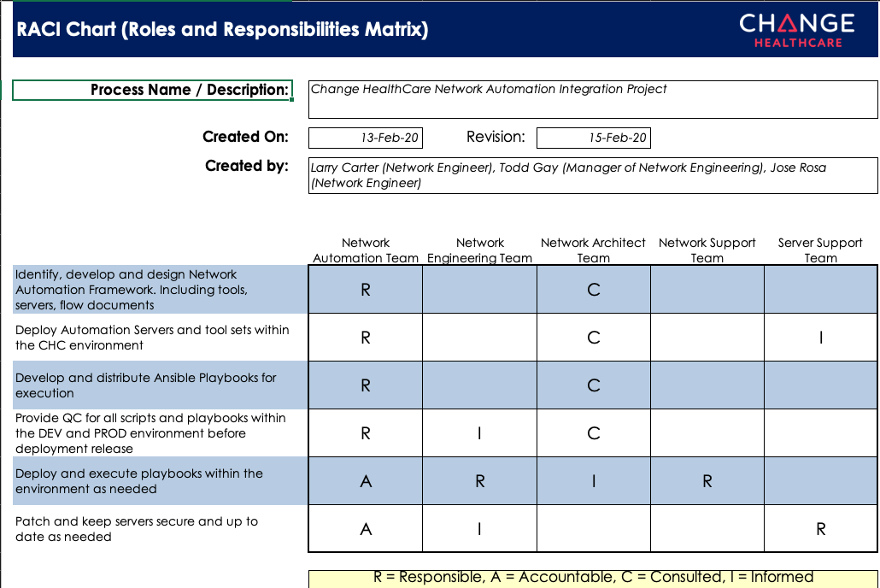

Slide 5







Deployment Roadmap to Success
Discover & Design
Weeks 2 - 8
Kickoff
Week 1
Server Buildout
Weeks 9 & 10
Testing
Weeks 11 - 13
Training
Week 15
Deployment / End User Rollout
Week 14

Slide 6







Week 1 – Kickoff Meeting
Meeting Agenda
Identifying Resources
Determine Automation Technologies
Define Security Concerns
Formulate Roadmap
Kickoff
Week 1
Discover & Design
Weeks 2 - 8
Framework Build
Weeks 9 & 10
Testing
Weeks 11 - 13
Deployment / End User Rollout
Week 14
Training
Week 15

Slide 7
Weeks 2 - 8 – Discover & Design
Discovery
Technologies to be automated
Existing automation scripts
Current configuration timelines
Existing Build Inconsistencies
Design
Toolsets Standards
Scripting Standards
Server Environment / location
Data Flows
Kickoff
Week 1
Discover & Design
Weeks 2 - 8
Framework Build
Weeks 9 & 10
Testing
Weeks 11 - 13
Deployment / End User Rollout
Week 14
Training
Week 15

Slide 8
Weeks 9 & 10 – Framework Build
Ansible
Define Deploy Version
Configure Inventory File
Configure .cfg File
GitLab
Develop Team Page
Define Authentication
Configure “.cfg” File
VSCode
Define Deploy Version
YAML/JSON standards
Bash integration
Kickoff
Week 1
Discover & Design
Weeks 2 - 8
Framework Build
Weeks 9 - 10
Testing
Weeks 11 - 13
Deployment / End User Rollout
Week 14
Training
Week 15

Slide 9
Weeks 11 - 13 – Testing
Testing
Develop Testing Sandbox
Add Technologies
Develop Scripts
Super-User testing
Kickoff
Week 1
Discover & Design
Weeks 2 - 8
Framework Build
Weeks 9 & 10
Testing
Weeks 11 - 13
Deployment / End User Rollout
Week 5
Training
Week 6

Slide 10
Week 14 – Deployment / End User Rollout
Deployment
Production Automation Scripts
Individually Manage Workloads
Monitor Production
Kickoff
Week 1
Discover & Design
Weeks 2 - 8
Framework Build
Weeks 9 & 10
Testing
Weeks 11 - 13
Deployment / End User Rollout
Week 14
Training
Week 15

Slide 11
Week 15 – Training
Training
Finalize Documentation
Confirm user access
Training provided for Engineering Team
Kickoff
Week 1
Discover & Design
Weeks 2 - 8
Framework Build
Weeks 9 & 10
Testing
Weeks 11 - 13
Deployment / End User Rollout
Week 14
Training
Week 15

